Slide 1

Expand course5-Traffic light
Yahboom
Yahboom OMIBOX Tutorial

Slide 2
1
2
3
4
5
Learning
goals
Search for
blocks
Combine
blocks
Experimental
phenomena
Preparation
程序编程
Tencent
Yahboom OMIBOX Tutorial

Slide 3
1
Preparation-1
1. The position of the RGB lights and color detection module in the robot car
2. Learn how to use RGB lights and identify graphically program building blocks
Yahboom OMIBOX Tutorial

Slide 4
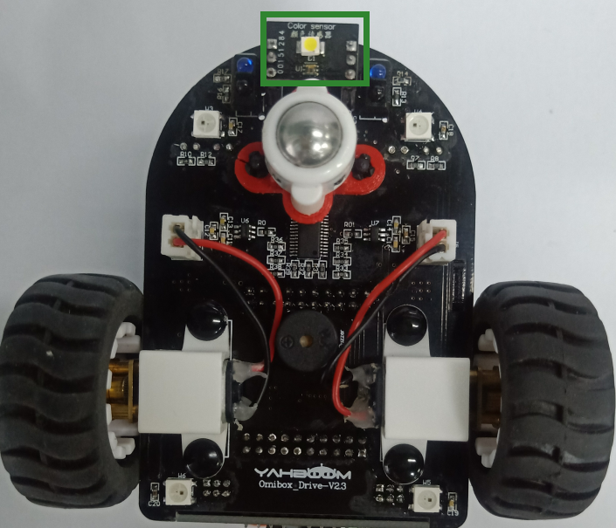
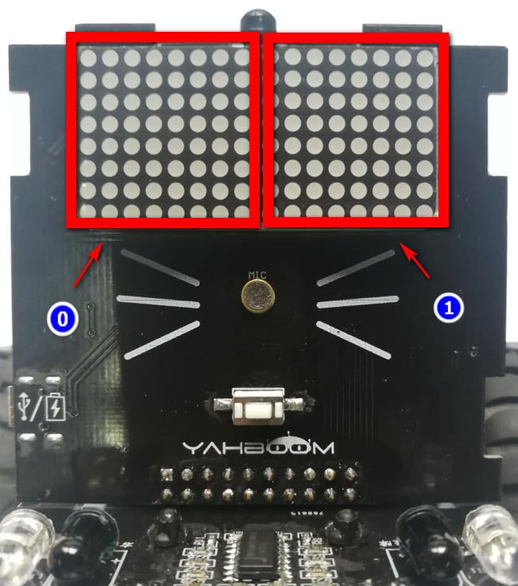
1
Preparation-2
As shown in the above picture, we circled LED matrix with a red wire frame,we circled the color detection module with a green wire frame.
Yahboom OMIBOX Tutorial

Slide 5
2
Learning goals
In this lesson, we will learn how to achiev, when the Omibox robot recognizes red, a stop people pattern is displayed on the LED matrix; when the Omibox robot recognizes green, a walking people pattern is displayed on the dot matrix.
Yahboom OMIBOX Tutorial

Slide 6
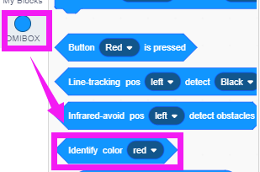
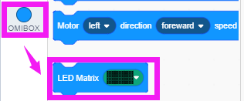
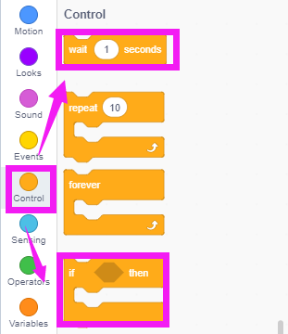
3
Search for blocks
The following is the location of the building blocks required for this programming.
Yahboom OMIBOX Tutorial

Slide 7
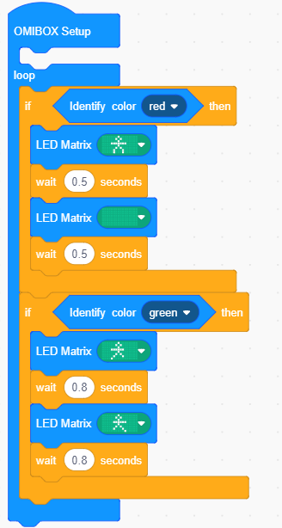
4
Combine blocks
The summary program is shown below:
Yahboom OMIBOX Tutorial

Slide 8
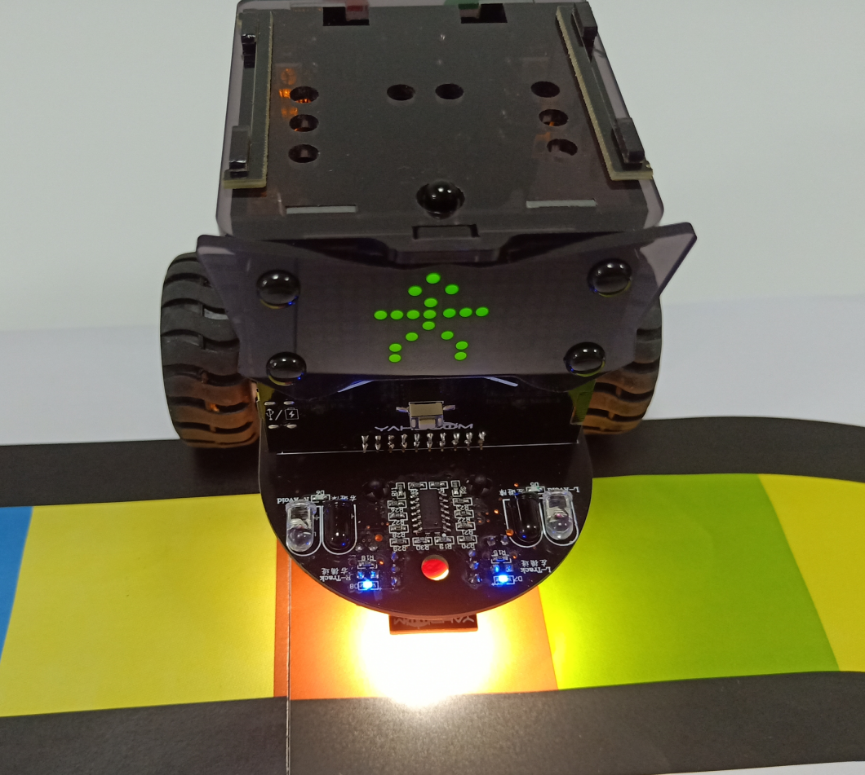
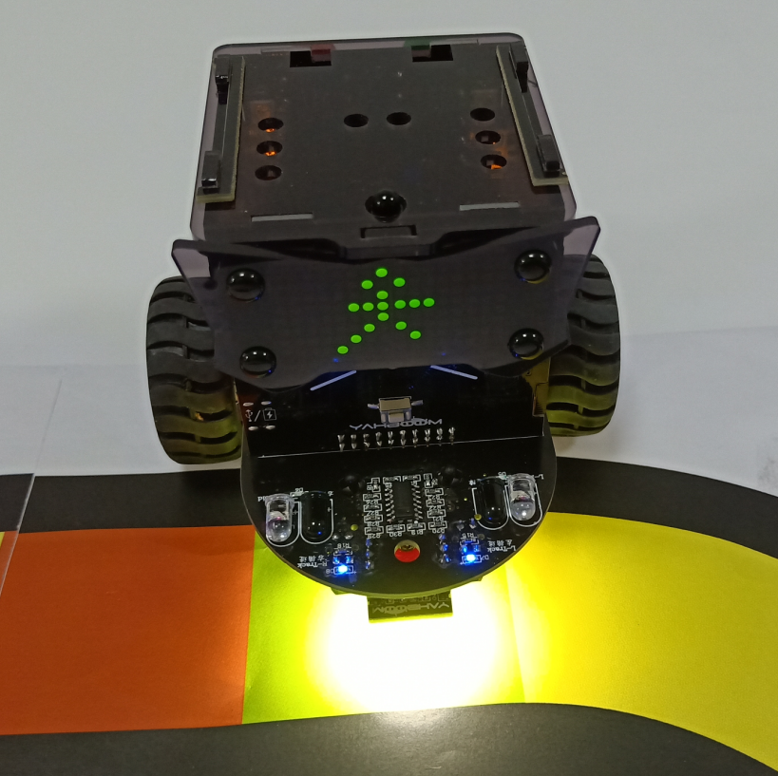
5
Experimental phenomena
After the program is uploaded, open the power of the robot car. When the Omibox robot recognizes red, a stop people pattern is displayed on the LED matrix; when the Omibox robot recognizes green, a walking people pattern is displayed on the dot matrix.
Yahboom OMIBOX Tutorial

Slide 9
Inspire Creativity Embrace Innovation
Thank you!!!
Yahboom

